Slide 1
Security by design
Ana Oprea-Oehlmann
2019-11-06 Berlin
Notes:
While security & reliability need to be central points in the system architecture, how secure and how reliable do you think systems should be?
I'd like to argue that 100% is never the reliability or security target you should aim for: not only is it impossible to achieve, it’s typically more reliability or security than users want or notice. Match the profile of your product to the risk the business is willing to take.
https://conferences.oreilly.com/velocity/vl-eu/public/schedule/detail/78937

Slide 2
Security & Reliability
Common properties
Different design considerations
Notes:
Notes from "Building Secure Reliable Systems", credits Adam Stubblefield, Massimiliano Poletto, Piotr Lewandowski‎.
September 27, 2012: Google-wide announcement - cascading failures
Google has an internal password manager that allows employees to store and share secrets for third-party services.
Password to the guest Wi-Fi system on the busses connecting the Bay Area campuses.
Transportation team emailed thousands employees that the Wi-Fi password had changed.
Spike in traffic far larger than the password management system — which had been developed years earlier for a small audience of system administrators
Primary replica became unresponsive
Load balancer diverted traffic to the secondary replica, which promptly failed in the same way
On-call engineer paged, no experience responding to failures of the service (no outage in its five years of existence)
Restart the service failed, the engineer did not know that a restart required a hardware security module (HSM) smart card.
Stored in multiple safes in different Google offices across the globe, but not on the US East Coast, where the oncall engineer was located.
Contacted a colleague in Australia to retrieve a smart card
Could not open the safe because the combination was stored in the now-offline password manager!!!
Another colleague in California had memorized the combination to the on-site safe and was able to retrieve a smart card.
After inserting the card into the reader, the service still failed to restart with the cryptic error, “The password could not load any of the cards protecting this key.”
The engineers in Australia decided to apply power drills to the task. An hour later, the safe was open, but even the newly retrieved cards triggered the same error message.
After 1h the team realized that the green light on the smart card reader did not, in fact, indicate that the card had been inserted correctly.
When the engineers flipped the card over, the service restarted and the outage ended.
Reliability and security are both crucial components of a truly trustworthy system, but building systems that are both reliable and secure is difficult. While the requirements for reliability and security share many common properties, they also require different design considerations. It is easy to miss the subtle interplay between reliability and security that can cause unexpected outcomes. The password manager’s failure was triggered by a reliability problem—poor load-balancing and load-shedding strategies—and its recovery was later amplified by multiple measures designed to increase the security of the system.

Slide 3
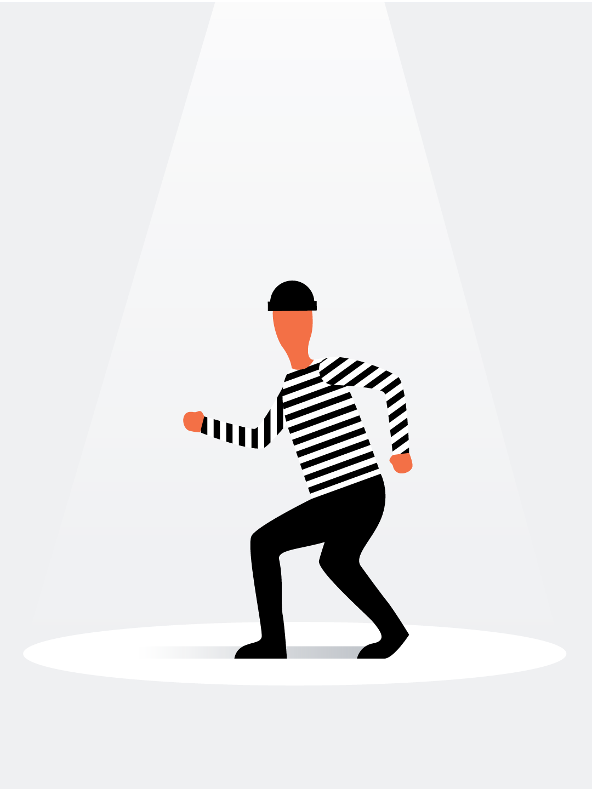
Managing Security Risk
Understanding Adversaries
Actor / Role
Motive
Actions
Target
Notes:
Notes from "Building Secure Reliable Systems", credits Heather Adkins, David Huska.
Innumerable forces are opposing the purpose of maintaining trustworthy systems— some deliberate, some accidental.
Fall into general categories that we can reason about when performing a risk analysis.
Understand attacker motivations by taking the people themselves into account.
First, establish a list of actors/roles who might interact with your product or organization.
Think of all the actions that may cause harm (including accidents) and potential targets (data, systems, etc.).
First computer hackers were hobbyists —curious technologists who wanted to understand how systems worked: motivated by their thirst for knowledge.
Vulnerability researchers use their security expertise professionally: motivated to make systems better, can be important allies to organizations seeking to secure their systems.
Every organization has insiders: current or former employees that are trusted with internal access to systems or proprietary knowledge.
An engineer with access to source code, unsatisfied with their performance review can retaliate by injecting a malicious backdoor into production that steals user data.
A financial analyst preparing the company financials working overtime can accidentally modifies the final yearly revenue numbers by a factor of 1000%.
An important "Risk assessment consideration" I'd like to highlight is the motive of adversaries:
March 2016, new type of ransomware—a malicious program that renders data or systems unavailable until the victim pays a ransom:
Petya appeared to be financially motivated.
A year later, new piece of malware that shared many elements of the original Petya program.
NotPetya, the new malware spread globally very quickly, but was primarily found on systems in Ukraine on the eve of a Ukrainian holiday.
Attackers compromised the software distribution mechanism of a company that made products explicitly for the Ukrainian market to infect victims.
Some researchers believe that this attack was carried out by a Russian state-sponsored actor in order to target Ukraine.
This example shows that motivated attackers can hide their motives and identity in creative ways—in this case, by disguising themselves as something potentially more benign.
Focus on how attackers work (their Tactics, Techniques and Procedures) before worrying about who they are specifically, since the identity and intent of attackers may not always be well understood.

Slide 4
Managing Security Risk
Design strategies
Least Privilege
Zero Trust
Multi-Party Authorization
Auditing and Detection
Recovery
Notes:
Notes from "Building Secure Reliable Systems", credits Heather Adkins, David Huska.
There are many design strategies for security that are applicable to protecting against both insider risk and malicious “outside” attackers.
Least Privilege: Granting the fewest privileges necessary to perform job duties, both in terms of scope and duration of access.
Zero trust: Designing automated or proxy mechanisms for managing systems so that insiders don’t have broad access that allows them to cause harm.
Multi-party authorization: Using technical controls to require more than one person to authorize sensitive actions.
Auditing and detection: Reviewing all access logs and justifications to make sure they're appropriate.
Recovery: The ability to recover systems after a destructive action, like a disgruntled employee deleting critical files or systems.

Slide 5
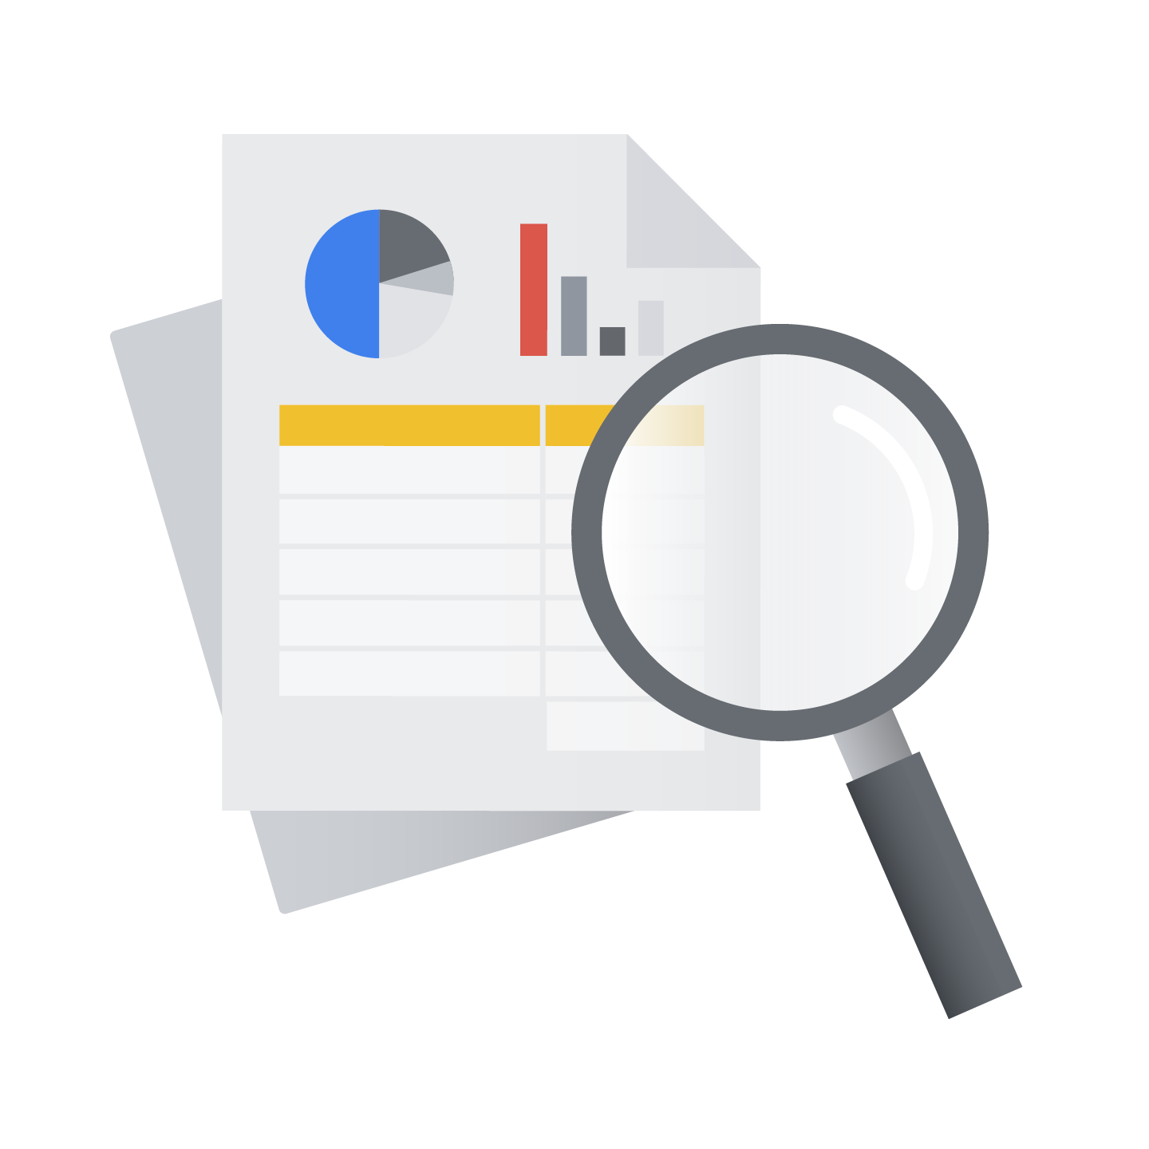
Managing Reliability Risk
Error budgets
All stakeholders in the organization have approved a Service Level Objective (SLO) reliability target as being fit for the product.
“Budget of unreliability” (or the error budget) represents the difference between 100% and the reliability target.
Notes:
Security and reliability are distinct practices with a significant overlap in purpose: to build and maintain trustworthy systems. A significant percentage of reliability issues are faults introduced by well-meaning engineers looking to push out exciting new features to users.
If for Understanding adversaries we're using risk-based approaches to estimate the costs of negative events, error budgets are a key element to balance your reliability needs against risky new adventures.
Notes from SRE book & workbook, credits Steven Thurgood, David Ferguson, Marc Alvidrez.
https://landing.google.com/sre/workbook/chapters/implementing-slos/
Service level objectives (SLOs) are key to making data-driven decisions about reliability.
An SLO sets a target level of reliability for the service’s customers. Above this threshold, almost all users should be happy with your product. Below, users are likely to start complaining or to stop using the product.
User happiness is what matters —generate revenue, place low demands on support teams, recommend the product to their friends.
We keep our services reliable to keep our customers happy. Fuzzy concept, can’t measure precisely.
https://landing.google.com/sre/sre-book/chapters/embracing-risk/ <- replaced the term "cluster" with datacenter, since cluster is Google specific and probably not relevant for the purpose of this example
How can you set a target level of availability?
Consider a massive-scale distributed storage system for structured data, Google Bigtable.
Some consumer services serve data directly from Bigtable in the path of a user request. Such services need low latency and high reliability.
Other teams use Bigtable as a repository for data that they use to perform offline analysis (e.g., MapReduce) on a regular basis. These teams tend to be more concerned about throughput than reliability.
Risk tolerance for these two use cases is quite distinct.
Meeting the needs of both use cases is far too expensive in practice.
Types of failures
Low-latency user wants Bigtable’s request queues to be (almost always) empty so that the system can process each outstanding request immediately upon arrival. (Inefficient queuing is often a cause of high tail latency.)
Offline analysis user is interested in system throughput, so request queues to never be empty. To optimize for throughput, never need to idle while waiting for its next request.
Success and failure are antithetical for these sets of users.
Cost
Partition the infrastructure and offer it at multiple independent levels of service.
In the Bigtable example, we can build two types of datacenters: low-latency and throughput.
The low-latency datacenters: short queue lengths, stringent client isolation requirements => substantial amount of slack capacity for reduced contention and increased redundancy are needed.
The throughput datacenters: run very hot and with less redundancy, optimizing throughput over latency: 10–50% of the cost of a low-latency cluster. Given Bigtable’s massive scale, this cost savings becomes significant very quickly.
Exposing cost through different SLOs motivates the clients to choose the level of service with the lowest cost that still meets their needs.
Vastly different service guarantees by adjusting a variety of service characteristics, such as the quantities of resources, the degree of redundancy, the geographical provisioning constraints, and, critically, the infrastructure software configuration.

Slide 6
Managing Reliability Risk
Design strategies
Least Privilege
Zero Touch
Multi-Party Authorization
Auditing and Detection
Recovery
Notes:
Notes from "Building Secure Reliable Systems".
There are many design strategies for security that are applicable to improving the reliability of a system:
Least Privilege: Running jobs with individual role-based credentials enables isolation and adds safety against bugs in the automation.
Zero Touch: Building upon the concept of least privilege through automation, we should aim to move to "Zero Touch" interfaces.
Humans have only indirect access to production through tooling
Automation makes predictable and controlled changes, aiming to reduce outages.
Multi-party authorization: Protects against malicious insiders and reduces the risk of accidental human errors, a common cause of reliability failures.
Auditing and detection: Planning and enforcing the use of shared resources such as CPU, memory, and network bandwidth can be achieved by examining logs, which should provide also the information of who accessed what.
Recovery: If you add policy to bound the rate automation can perform a change, you can prevent systems from making the wrong changes too quickly
This can decrease the scope of an issue.
If your systems are maliciously compromised, premature recovery or clean-up actions can cause other problems—for example, tipping off an adversary that they've been discovered.

Slide 7
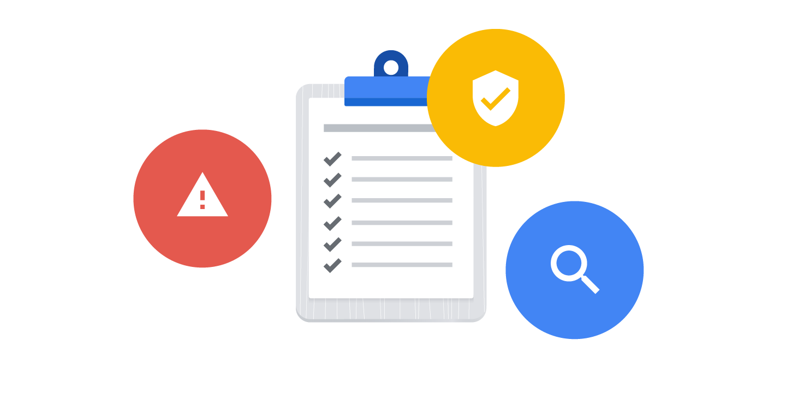
Shift Security & Reliability left
Commitment to the full system lifecycle.
Security & Reliability central elements in the architecture of systems.
Notes:
Notes from "Building Secure Reliable Systems", credits Ana Oprea, Heather Adkins.
Security by design is increasingly important in a world where many products are connected to the internet, and where cloud technologies are becoming more prevalent.
The more we come to rely on those systems, the more reliable they need to be; the more trust we place in their security, the more secure they need to be.
Can a system ever truly be considered reliable if it isn't fundamentally secure? Or can it be considered secure if it's unreliable?
Successfully building, deploying, monitoring, and maintaining systems requires a commitment to their full lifecycle.
The commitment to the full system lifecycle is only possible when security and reliability are central elements in the architecture of systems.

Slide 8
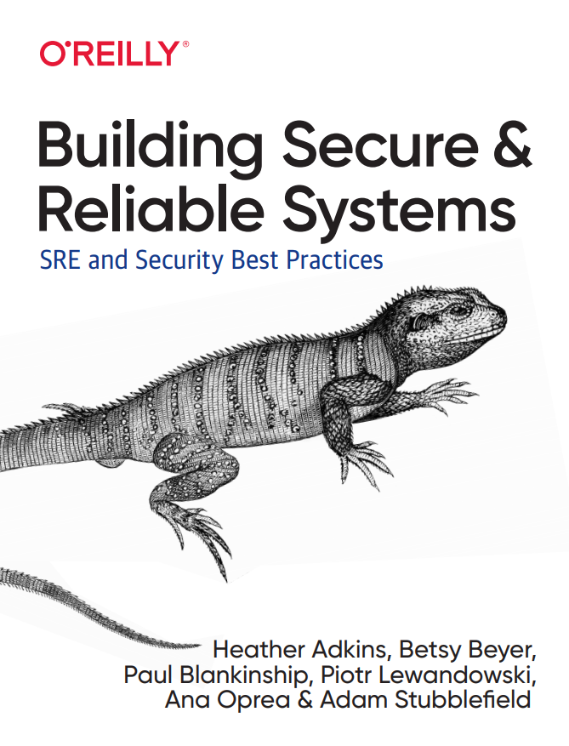
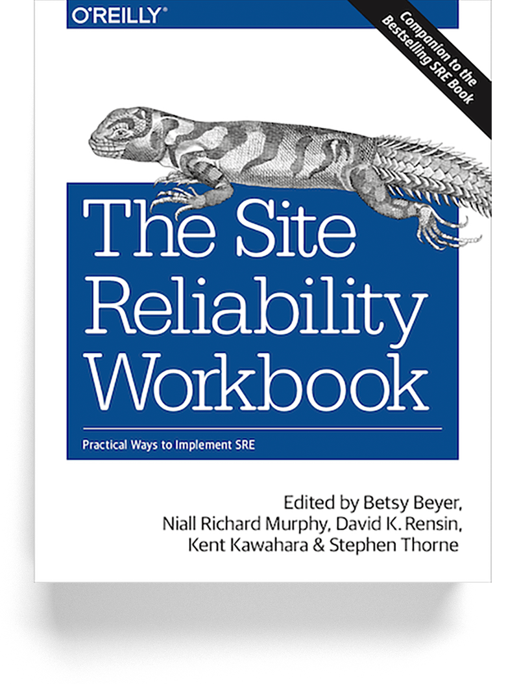
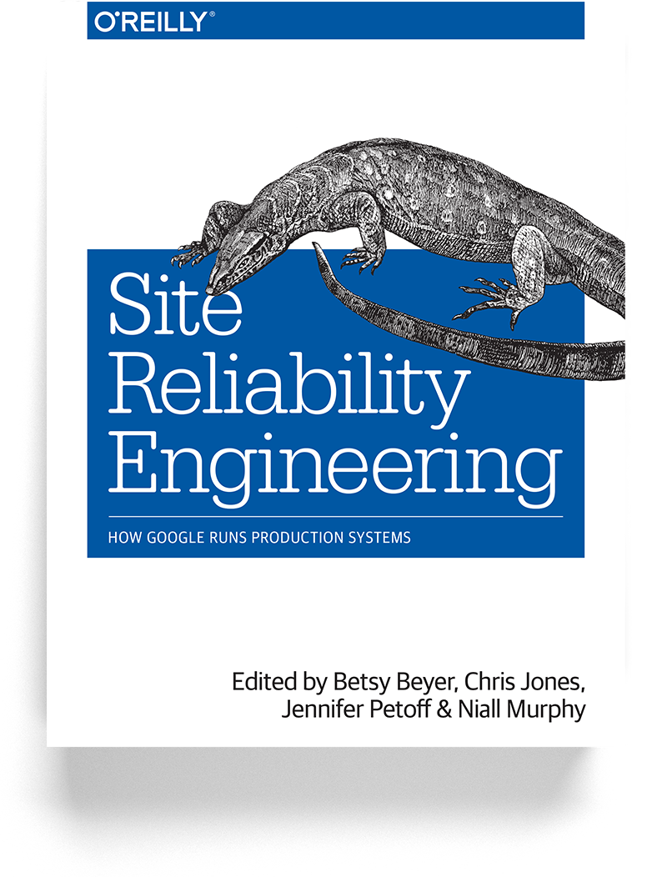
Thank you!
anaoprea@google.com
@0xa6ea
Notes:
https://amazon.com/Building-Secure-Reliable-Systems-Practices/dp/1492083127/ref=sr_1_1
https://landing.google.com/sre/books/

